Slide 1
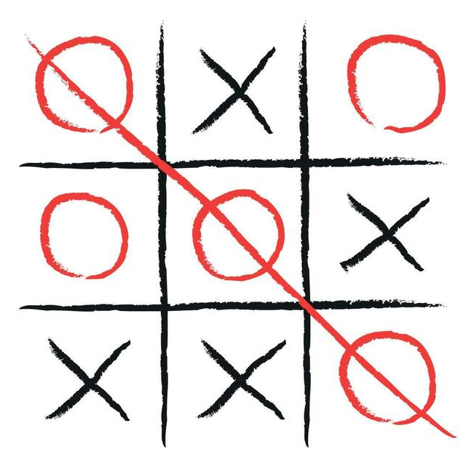
GROUP 2:
TIC TAC TOE
GAME
CSE 115 - PROGRAMMING LANGUAGE
Nadia Nower 2612723642
Humira Anjum 2614017042
Toufa Mahmud 2613557642
Halimatuz Lubana Biva 2613007042

Slide 2
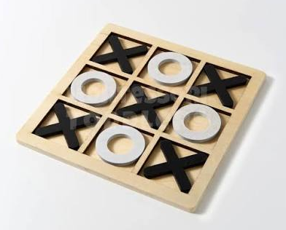
Introduction
01
Group 2 Nadia Nower Humira Anjum Toufa Mahmud Halimatuz Lubana Biva

Slide 3
A 3x3 grid is used to play the traditional logic game Tic-Tac-Toe.
In order to win the game, two players alternately enter the symbols "X" or "O" to align three identical symbols horizontally, vertically, or diagonally.The game is a draw if the board is completely filled and neither player can achieve this alignment.
The project uses the C programming language to create a local competitive version of the game, emphasizing procedural logic, modular function design, and strong input validation to guarantee a flawless user experience.
Group 2 Nadia Nower Humira Anjum Toufa Mahmud Halimatuz Lubana Biva

Slide 4
Declaring a global 3x3 board for the game.
Implemented resetBoard( ) - to clear and refresh the board each round.
Built the main loop-to keep the game running until a win or draw is declared.
Added player switching logic - Alternates turns between player 1 and player 2 which ensures fair and smooth gameplay
Foundation of Gameplay:
Group 2 Nadia Nower Humira Anjum Toufa Mahmud Halimatuz Lubana Biva

Slide 5
Core Approach
02
Group 2 Nadia Nower Humira Anjum Toufa Mahmud Halimatuz Lubana Biva

Slide 6
The drawBoard ( ) function was designed to be simple and clear. We used vertical bars ( | ) and horizontal dashes (- - -) to create a recognizable 3x3 grid. This ensures that the screen refreshes every turn.
The game follows a “top-down” design:
Input : Get the number from the player.
Process : Update the 2D array and check the rules.
Output : Show the new board with ‘X’ or ‘O’ in the cell.
This design ensures the game doesn’t crash if the player enters a wrong number.
Group 2 Nadia Nower Humira Anjum Toufa Mahmud Halimatuz Lubana Biva

Slide 7
Game Logic
03
Group 2 Nadia Nower Humira Anjum Toufa Mahmud Halimatuz Lubana Biva

Slide 8
The game board us stored as char board[3][3]; where the user inputs numbers from 1 to 9.
It is converted into 2D indices using:
row = (choice - 1) / 3;
col = (choice - 1) % 3;
This allows the computer to know exactly which square the player clicked.
Then the loop does three things in order:
Draw the latest board on the screen so the players can see it.
Swaps the turn from player 1 to player 2.
Checks if the number typed is a valid move or not.
Group 2 Nadia Nower Humira Anjum Toufa Mahmud Halimatuz Lubana Biva

Slide 9
Bug Fixes
04
Group 2 Nadia Nower Humira Anjum Toufa Mahmud Halimatuz Lubana Biva

Slide 10
During testing, when a letter was typed accidentally instead of a number, the program went on an infinite loop and crashed.
To fix this issue the getchar(); function was used as opposed to only scanf. It cleared out unwanted input from the program.
if (scanf("%d", &choice) != 1) {
while(getchar() != '\n'); // The "Cleaner"
continue;
}
The outcome of this change ensured a much smoother gameplay and 100% stable input handling from the user
Group 2 Nadia Nower Humira Anjum Toufa Mahmud Halimatuz Lubana Biva

Slide 11
Conclusion & Future Improvements
05
Group 2 Nadia Nower Humira Anjum Toufa Mahmud Halimatuz Lubana Biva

Slide 12
So we have developed a robust, bug-free Tic-Tac-Toe console game which has been designed for fast, competitive local play. This project allowed as to demonstrate all of the core C programming concepts which were learnt over this semester.
Future Scope:
Expand to a 4×4 or NxN board
Implement Minimax AI opponent
Add score tracking system
Upgrade to GUI-based version
Group 2 Nadia Nower Humira Anjum Toufa Mahmud Halimatuz Lubana Biva

